Slide 1
Literature Review
By: Khush Lalchandani

Slide 2
Abstract
This presentation covers advancements in lane detection and safety analysis for autonomous vehicles. The first paper focuses on implementing an Inverse Perspective Mapping (IPM) algorithm to correct perspective distortions for improved lane tracking. This transforms a picture from a vehicle to a birds eye view image. The second paper integrates DBSCAN and RANSAC algorithms with IPM to enhance the lane detection. The third paper develops a model for safe and comfortable lane-changing maneuvers, using polynomial trajectory planning and MATLAB simulations for validation.

Slide 3
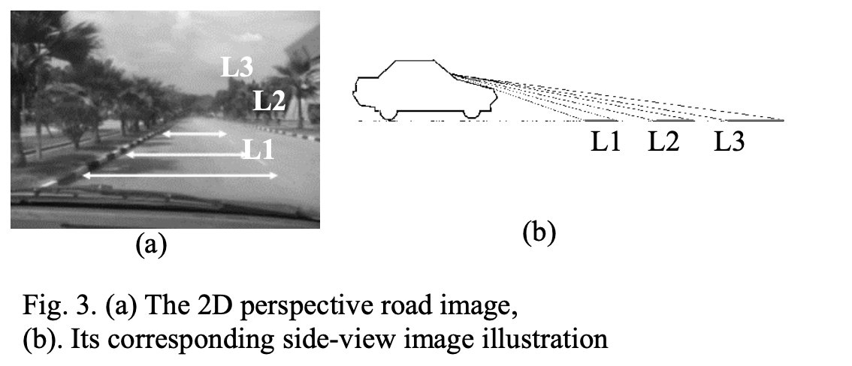
Paper 1: Implementation of Inverse Perspective Mapping Algorithm
Objective: Correct perspective distortions in vehicle-mounted camera images
Enhance accuracy of lane tracking systems

Slide 4
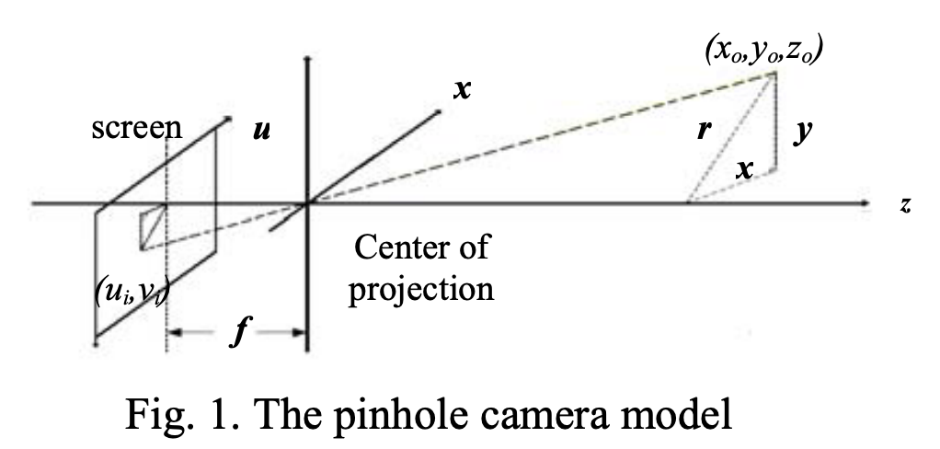
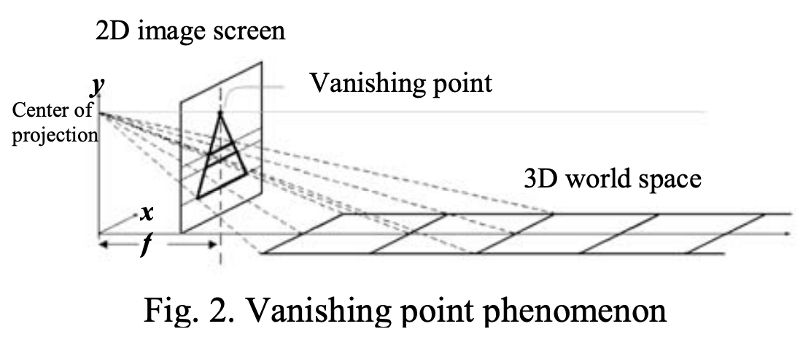
Methodology
Use IPM to transform 2D perspective view to bird’s eye view
Apply geometrical transformations using a pinhole camera model
Proper camera placement
Adjust yaw and tilt angles

Slide 5
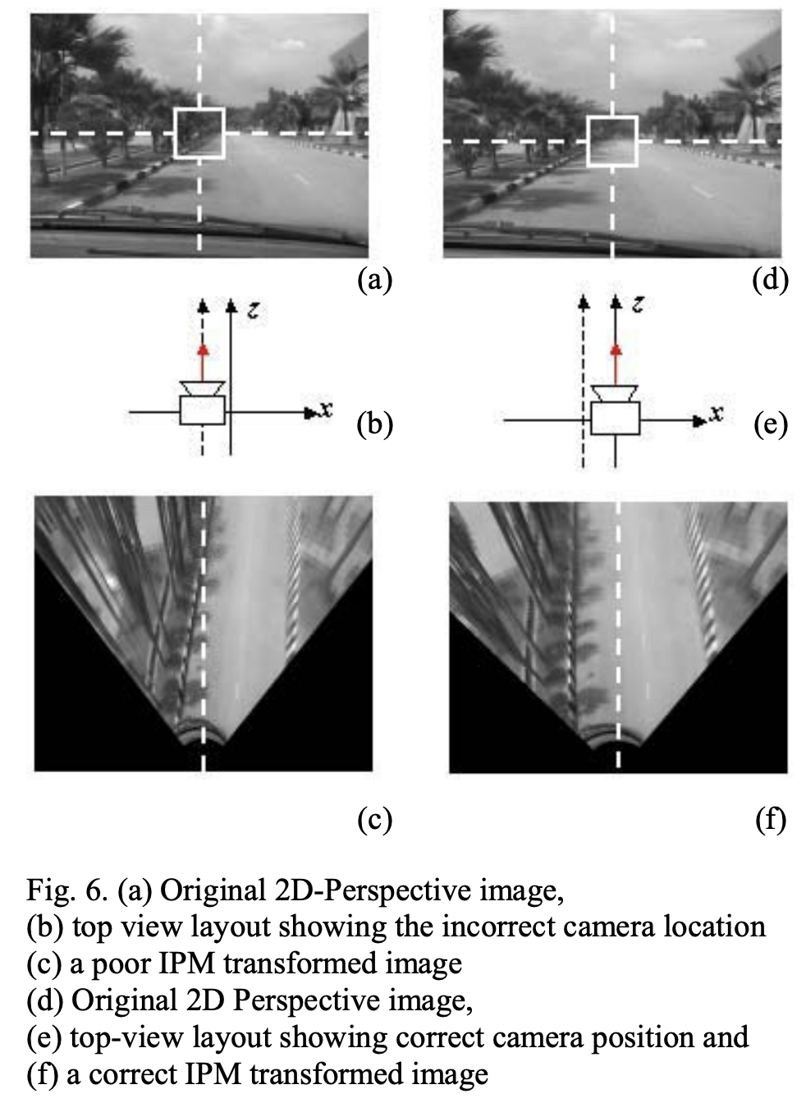
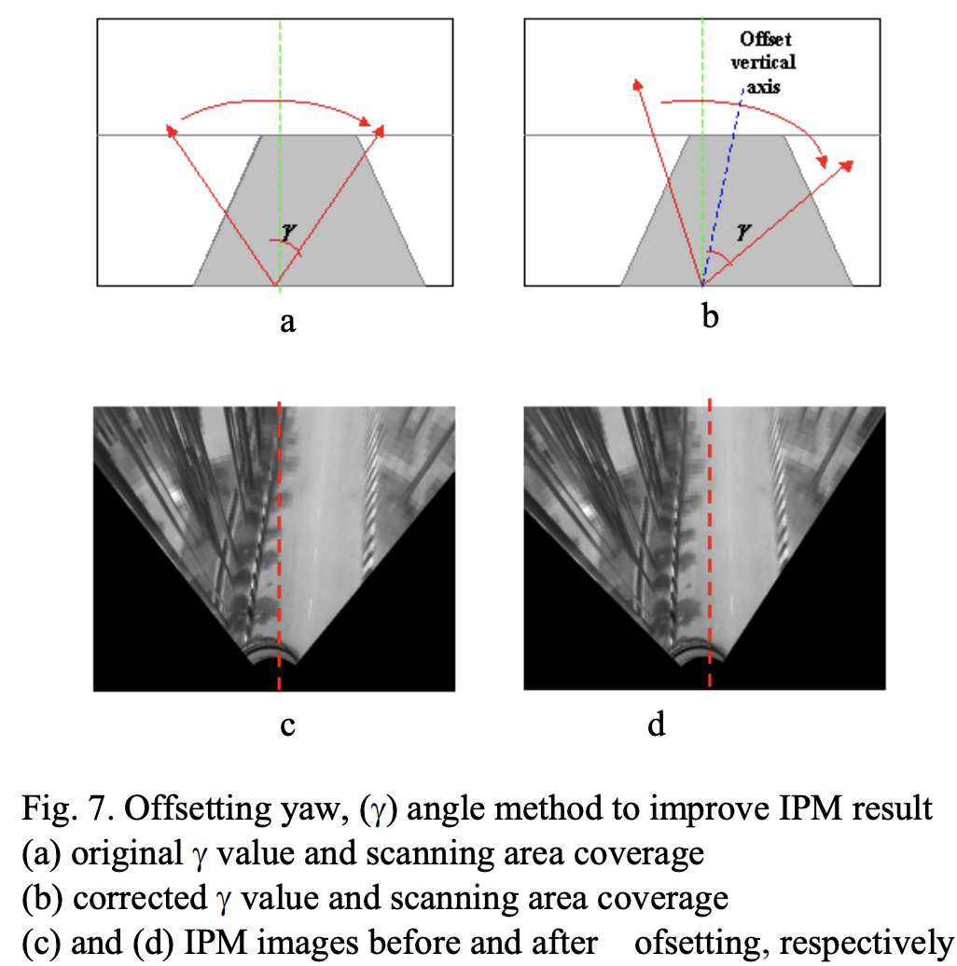
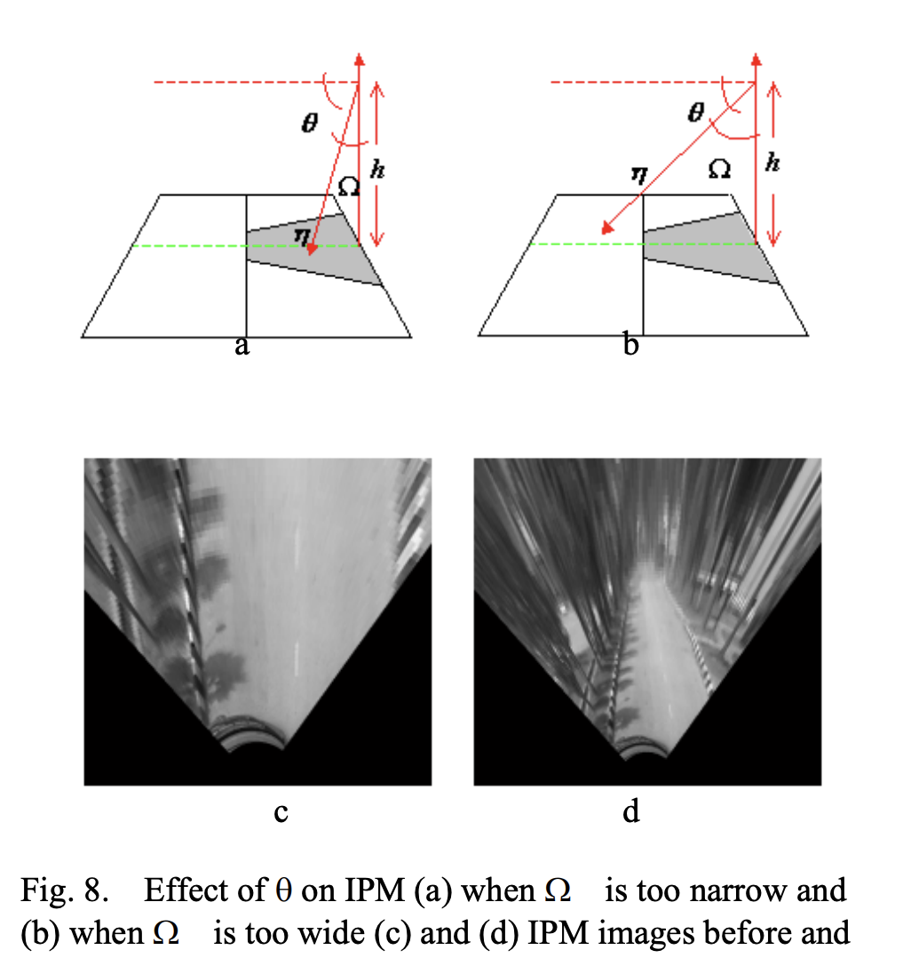
Implementation Details

Slide 6
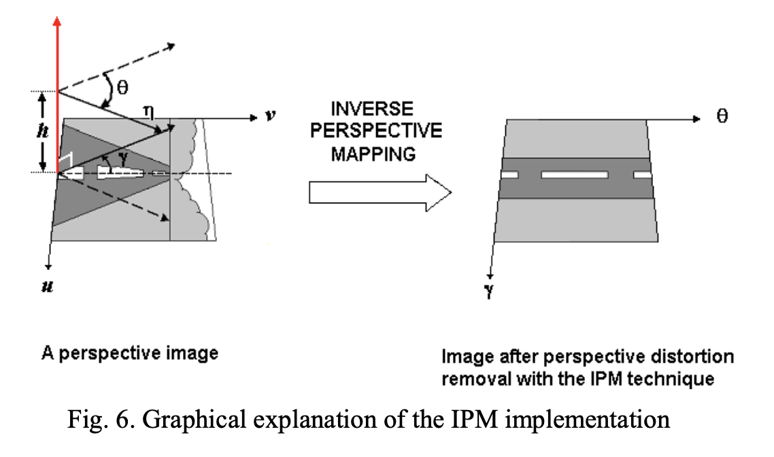
Results and Findings
Successful removal of perspective distortions
Improvement in lane tracking accuracy
Validated through real-world tests and simulations

Slide 7
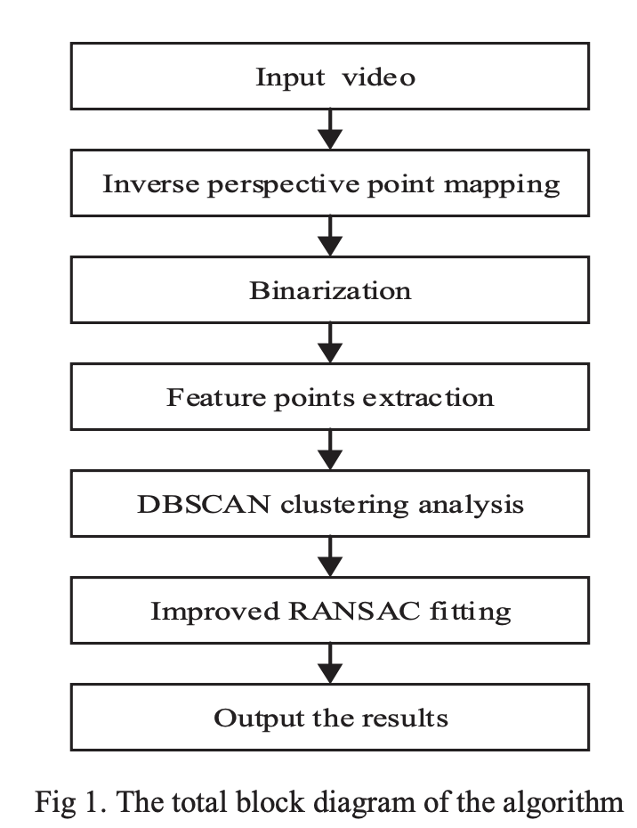
Paper 2: Using DBSCAN and RANSAC for Lane Detection
Objective: Integrate DBSCAN and RANSAC with IPM for lane detection.
Reduce noise and improve model accuracy

Slide 8
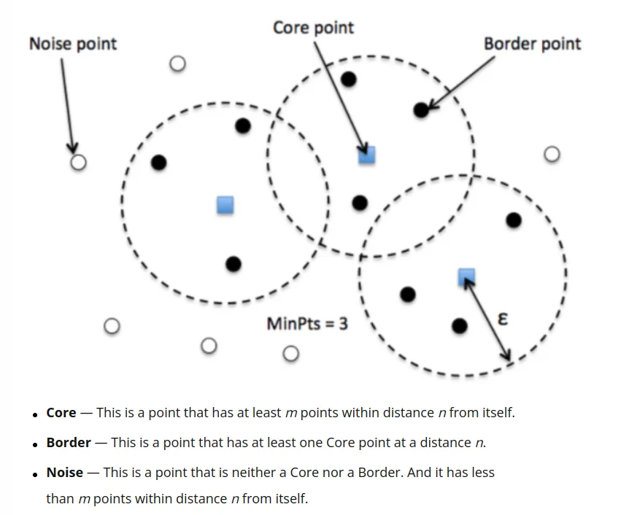
DBSCAN (Density-Based Spatial Clustering of Applications with Noise)
Clustering Method: Groups points into clusters based on density
Core Points: Points with at least MinPts neighbors within distance ε
For each core point in the cluster, add all points within its ε neighborhood that haven't been visited to the cluster

Slide 9


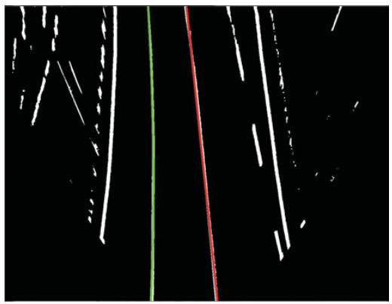
Improved RANSAC (Random Sample Consensus)
Randomly select a small subset of the data points(3)
Estimate the curve
Select five points from curve in order and calculate difference from actual value
Check the condition, d ≤ t, t is the set threshold
If incorrect, repeat with new random values

Slide 10
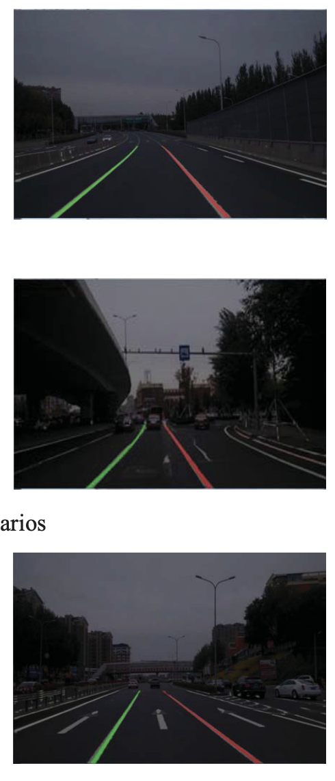
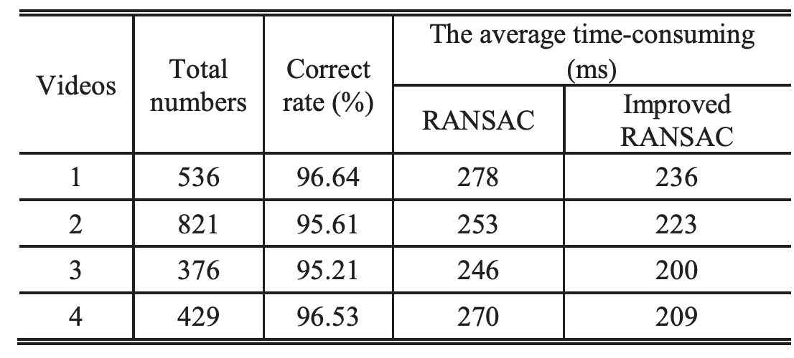
Results and Findings
Effective real-time lane detection and noise reduction

Slide 11
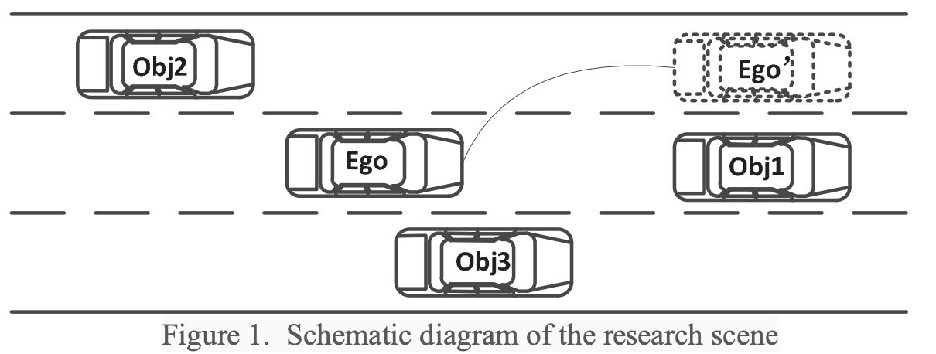
Paper 3: Safety of Lane Change Analysis for Autonomous Vehicles
Develop a model for safe lane-changing maneuvers
Minimize risk and enhance comfort during lane changes
High speed traffic scenario

Slide 12
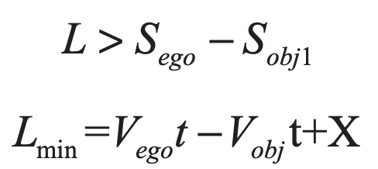
Methodology
L is the distance between ego and obj1
S is the longitudinal displacement distance in the lane changing process
V represents the speed, t is the lane changing time, and X is the safety margin

Slide 13
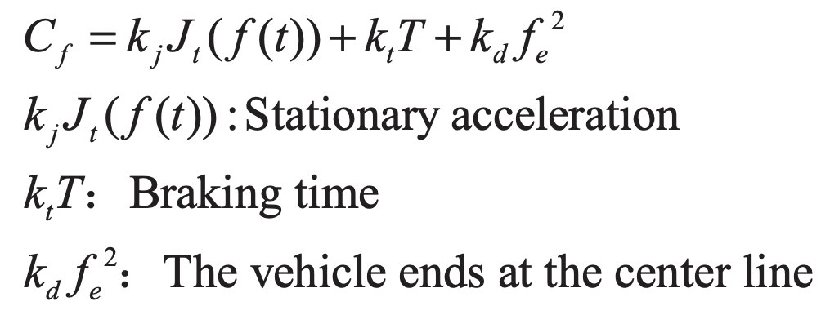
Methodology
Loss function in a high-speed environment
Lange change path(quintic polynomial) is analyzed for optimal path
If optimal trajectory or sub-optimal lane change trajectory does not meet the safety judgment, lane change is cancelled.

Slide 14
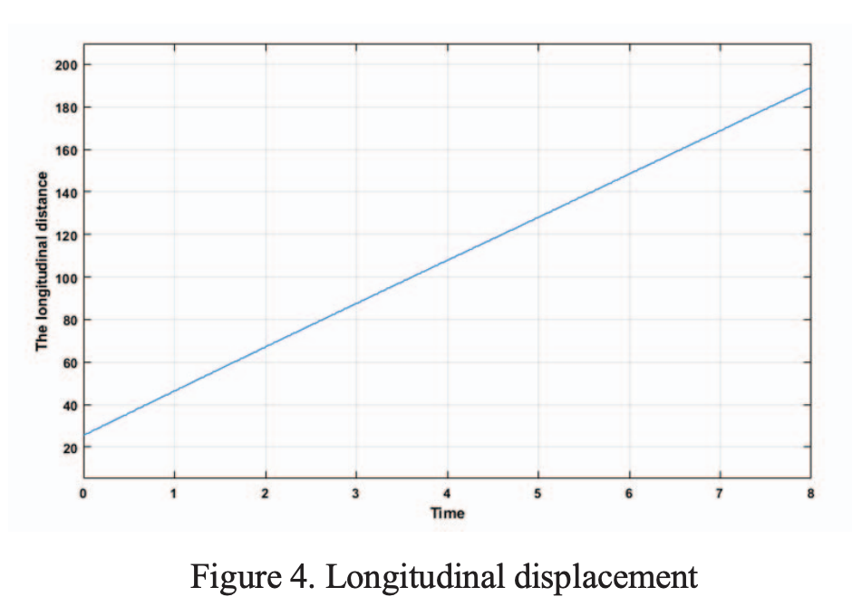
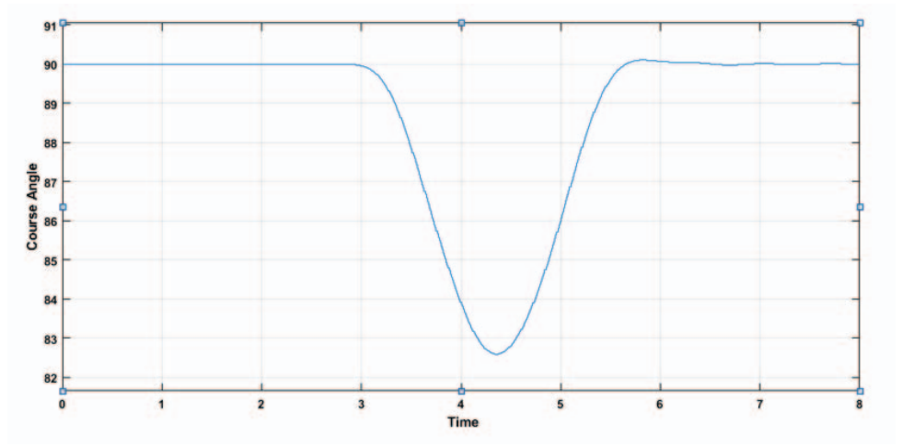
Results and Findings
Modeling and simulation test were carried out in MATLAB
Results show safe and smooth lane change
(Constant Slope)

Slide 15
Conclusion and Future Research
Integration of advanced algorithms like IPM, DBSCAN, and RANSAC significantly improves lane detection and safety in autonomous driving.
Polynomial trajectory planning improves the safety and comfort of lane-changes
Future Research:
Develop more comprehensive models that consider complex driving conditions and vehicle dynamics for improved lane change safety analysis
Create adaptive algorithms that can learn from new data and improve over time

Slide 16
References
A. M. Muad, A. Hussain, S. A. Samad, M. M. Mustaffa and B. Y. Majlis, "Implementation of inverse perspective mapping algorithm for the development of an automatic lane tracking system," 2004 IEEE Region 10 Conference TENCON 2004., Chiang Mai, Thailand, 2004, pp. 207-210 Vol. 1, doi: 10.1109/TENCON.2004.1414393. keywords: {Cameras;Road accidents;Equations;Automotive engineering;Road vehicles;Vehicle detection;Systems engineering and theory;Nanoelectronics;Shape;Predistortion},
J. Wang, W. Hong and L. Gong, "Lane detection algorithm based on density clustering and RANSAC," 2018 Chinese Control And Decision Conference (CCDC), Shenyang, China, 2018, pp. 919-924, doi: 10.1109/CCDC.2018.8407261. keywords: {Clustering algorithms;Feature extraction;Real-time systems;Robustness;Image segmentation;Roads;Classification algorithms;Lane detection;DBSCAN clustering algorithm;Improved RANSAC fitting},
K. Ouyang, Y. Wang, Y. Li and Y. Zhu, "Lane change decision planning for autonomous vehicles," 2020 Chinese Automation Congress (CAC), Shanghai, China, 2020, pp. 6277-6281, doi: 10.1109/CAC51589.2020.9327195. keywords: {Trajectory;Mathematical model;Safety;Autonomous vehicles;Analytical models;Planning;Acceleration;lane change intention;gain function;polynomial;track change;loss function},

